Slide 1
Leveraging the Microsoft Graph with MSGraphClient
Sathish Nadarajan
@contactsathish

Slide 2

MS Graph
Microsoft Graph JavaScript SDK
Microsoft Graph TypeScript type declarations
SPFx’s MSGraphClient
Demo
Resources

Slide 3

Microsoft 365 Platform
Extend Microsoft 365 experiences
web, device, and service apps
Build your experience
Documents
Pages
Conversations
Timeline
iOS/Android/Windows/Web
1
Microsoft Graph
Notes:
Our Office 365 developer vision focuses on the Users’ experience and their data. As a developer you can bring your applications into their user experience. With over 1.2+ billion users of Office Worldwide, this is a huge opportunity to provide a window into your applications. As well as being able to connect into their data and add intelligence to your applications. There are currently 850 million events created a month and a total of 470Pb+ of data stored in the service that can add value to for our Users’.

Slide 4

Microsoft Graph Gateway to your data in the Microsoft-cloud
https://graph.microsoft.com
Office 365
Windows 10
Enterprise Mobility + Security
Users, Groups, Organizations
Outlook
SharePoint
OneDrive
Teams
Planner
Excel
OneNote
Activities
Device Relay
Commands
Notifications
Azure AD
Intune
Identity Manager
Advanced Threat Analytics
Advanced Threat Protection
Mail, Calendar,
Contacts and Tasks
Sites and Lists
Drives and Files
Channels, Messages
Tasks and Plans
Spreadsheets
Notes, and more…
Identity Management
Access Control
Synchronization
Domains
Administrative Units
Applications and Devices
Advanced Threat Analytics
Advanced Threat Protection
Alerts
Policies
and more…

Slide 5
Accessing the Microsoft Graph
Direct REST API
Any platform
Any language
Any framework
Native SDKs
Utilize framework & platform specific implementations
Abstracts the details of constructing & processing REST requests over HTTP
.NET, iOS, Android, PhP, Ruby, JavaScript, etc.

Slide 6
Microsoft Graph, gateway to Office 365
Single resource that proxies multiple Microsoft services
Allows for easy traversal of objects and relationships
Simplifies token acquisition and management
Eliminates the need to traditional discovery (using “me” and “myorganization”)

Slide 7
Accessing the Microsoft Graph
Direct REST API
Any platform
Any language
Any framework
Native SDKs
Utilize framework & platform specific implementations
Abstracts the details of constructing & processing REST requests over HTTP
.NET, iOS, Android, PhP, Ruby, JavaScript, etc.

Slide 8
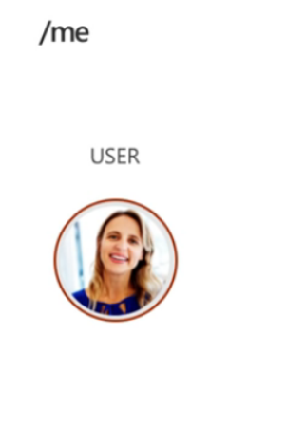
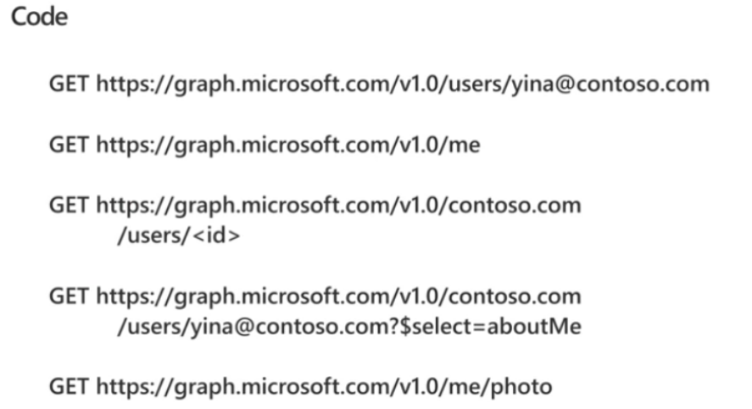

Slide 9
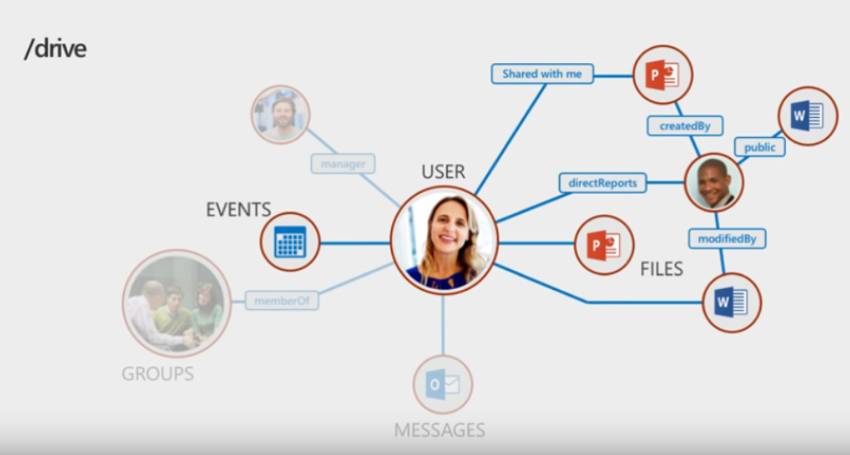

Slide 10
Microsoft Graph JavaScript SDK
Microsoft Graph is accessible via REST API & various SDKs
Client-side solutions can leverage the JavaScript SDK
The Microsoft Graph JavaScript client library is a lightweight wrapper around the Microsoft Graph API that can be used server-side and in the browser.
https://github.com/microsoftgraph/msgraph-sdk-javascript
Requires initialization with an Azure AD provided OAuth2 access token to create the client
Notes:
Let’s review from the previous section

Slide 11
Initializing the Microsoft Graph JS SDK
var client = MicrosoftGraph.Client.init({
authProvider: (done) => {
done(null, access_token);
}
});
client
.api('/me')
.get((err, res) => {
console.log(res);
});

Slide 12
Microsoft Graph TypeScript Type Declarations
Use the Microsoft Graph JavaScript SDK in TypeScript applications
TypeScript type declarations introduce strong types and documentation to client-side projects
https://github.com/microsoftgraph/msgraph-typescript-typings

Slide 13
Microsoft Graph TypeScript Type Declarations
import * as MicrosoftGraph from '@microsoft/microsoft-graph-types';
// init Microsoft Graph client
client
.api('/me')
.get((error: any, user: MicrosoftGraph.User, rawResponse?: any) => {
console.log('name: ', user.displayName);
console.log('email: ', user.displmailayName);
console.log('phone: ', user.businessPhones[0]);
});
});

Slide 14
SharePoint Framework’s Microsoft Graph Client

Slide 15
Office 365 and SharePoint Online Users Already Authenticated
Users in Office 365 are already authenticated
SharePoint Online & Office 365 share the same Azure AD dependency as Microsoft Graph
Users login to Office 365 with their Work & School account (Azure AD)
Calls to the Microsoft Graph are proxied through SharePoint Online
Eliminates the need for creation of a separate Azure AD application
Does not bypass any permission / scope requirements
Can only access business entities, not consumer entities

Slide 16
Calling Secured Services from Client-side Code is a Challenge
Calling a secured service, like Microsoft Graph, requires the acquisition of a token
Authenticate and get authorized with Azure AD using an Azure AD application
Interactive login & programmatic acquisition of access token
Client-side applications cannot securely do this across domains seamlessly
Can’t store application ID’s and secrets client side as they cannot be protected
Require an authentication prompt with a popup or redirection

Slide 17
Solution: Proxy Calls to Secured Services through Existing Application
SharePoint Online already has an Azure AD application
Client-side solutions in SharePoint Online call the SharePoint REST API in the same domain
No extra authentication required
Provided these tenants have granted the necessary scopes, SharePoint will call the Microsoft Graph
Responses from the Microsoft Graph are returned back to the client-side application
Permission requests to Azure AD applications (aka: resources) must be approved
Only SharePoint Online tenant administrators can grant / reject permission requests
Approved permissions are available to all client-side solutions in a tenant

Slide 18
SharePoint Framework Includes a Microsoft Graph Client
MSGraphClient: SharePoint Framework’s Microsoft Graph Client
Abstracts the token acquisition from the SharePoint Framework’s support for Azure AD
Wraps the Microsoft Graph JavaScript SDK and initializes it with one line that returns a promise
this.context.msGraphClientFactory
.getClient()
.then((client: MSGraphClient): void => {
// use MSGraphClient here
});

Slide 19
Reading further
Microsoft Graph
https://developer.microsoft.com/graph
Microsoft Graph JavaScript SDK
https://github.com/microsoftgraph/msgraph-sdk-javascript
SharePoint Framework Documentation
https://docs.microsoft.com/sharepoint/dev/spfx/sharepoint-framework-overview
Use the MSGraphClient to Connect to Microsoft Graph
https://docs.microsoft.com/sharepoint/dev/spfx/use-msgraph

Slide 20

Enjoy the Bootcamp

Slide 21

Call to action
Share your feedback on Bootcamp at https://aka.ms/Microsoft365DevBootcampSurvey2019
Join Office 365 developer program https://dev.office.com/devprogram to leverage all resources for Office 365 development learning
Build applications on Office 365 platform
Attend MVP led local community events to continue learning on Office 365 development

